Slide 1
EE-2003 Computer Organization and Assembly Language Fall 2026
Course Instructor : Dr. Maqsood M. Khan
Department of Computer Science/Software Engineering/Artificial Intelligence

Slide 2
Why This Course Matters
Computer Science
Your algorithms only run fast if you know what the machine underneath is doing.
Computer Engineering
Buses, registers and memory maps are the hardware you will design and debug.
Software Engineering
Performance and memory bugs live below the language you write in.
Artificial Intelligence
AI speed is a memory-bandwidth problem: caches, precision and data movement.
Compilers, operating systems and ML frameworks are all built on this layer.

Slide 3
Course Information
Text and Reference Books
Course Outline available on Google Class Room
Course Objectives and outcomes
Available on Google Class Room
Lecture material will be available on GCR
Regularly review the lectures discussed in the class
Prior knowledge of Courses required
ITC and DLD

Slide 4
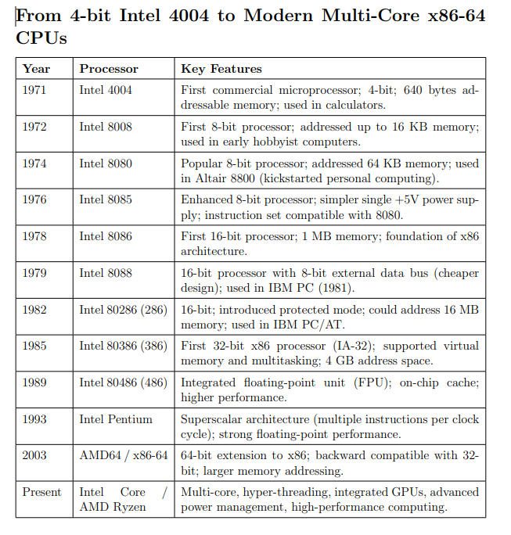

Slide 5
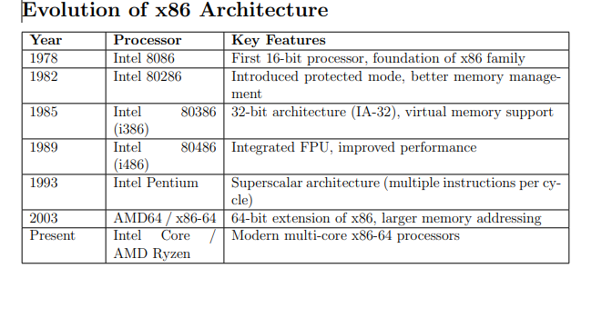

Slide 6
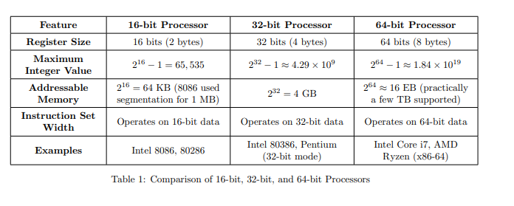

Slide 7
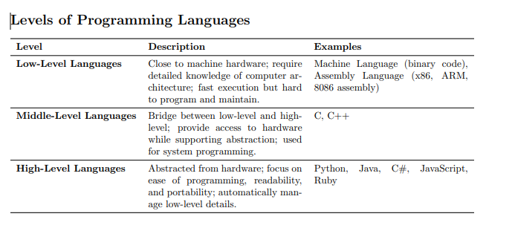
Languages Generations!

Slide 8
Some Basics- Quick Review

Slide 9
Lecture Overview
Numbering & Coding Systems
Digital Primer
Semiconductor Memory

Slide 10
Numbering & Coding Systems
Decimal, Binary and Hexadecimal Number Systems
Interconversion Between these Systems
-converting from decimal to binary and binary to decimal
-converting between binary and hex
-converting from hex to decimal
-addition/subtraction of binary and hex numbers

Slide 11
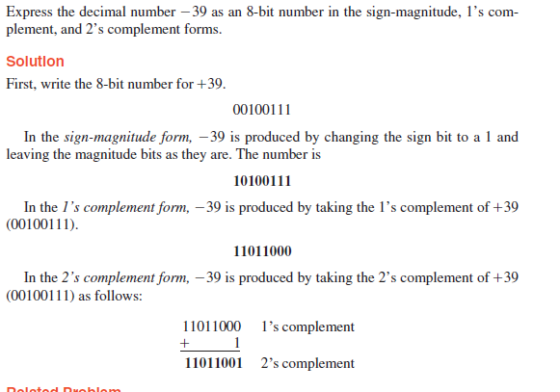
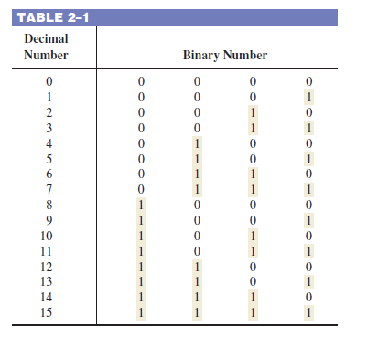

Slide 12
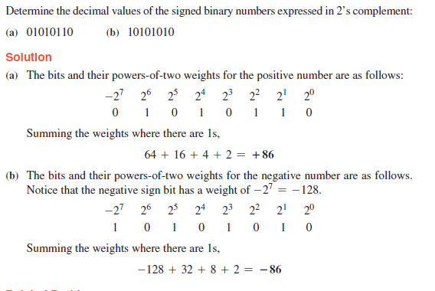

Slide 13
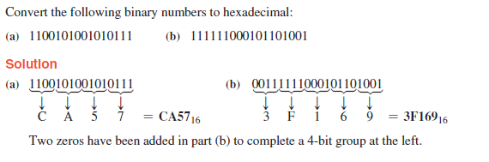

Slide 14
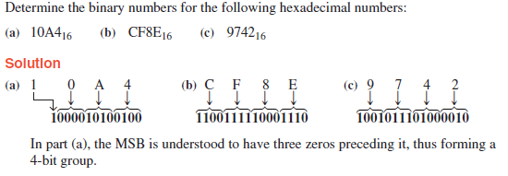

Slide 15
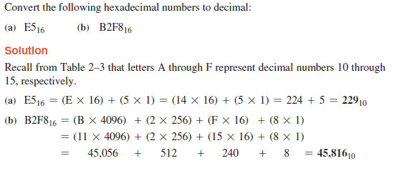

Slide 16
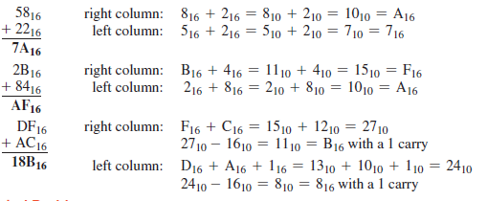

Slide 17
Digital Primer
What is digital logic?
Logic gates are put together to form simple digital circuits, i.e Adders, subtractor, decoder etc

Slide 18

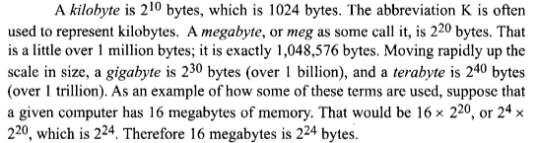
SemiConductor Memory

Slide 19
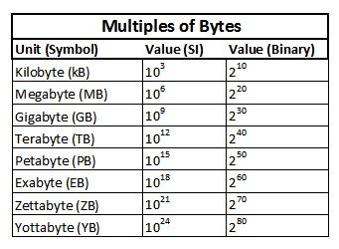
Important Terminologies !

Slide 20
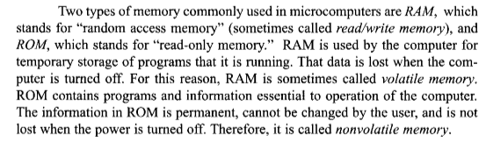
RAM & ROM

Slide 21
Organization of Computers
CPU
Address Bus
Control Bus
RAM/ROM
I/O Device
Data Bus

Slide 22
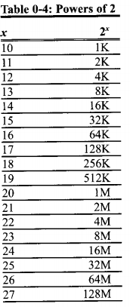
Organization of Computers
Address Bus
Size of Memory accessible by Processor
64 K locations = 16 bit address
4 GB = 32 bit; 16 EB = 64 bit
Data Bus
Chunk of Data accessible
8-bit data Bus accesses 1 byte
16-bit data Bus accesses 2 bytes
64-bit data Bus accesses 8 bytes
RAM
Stores program and data which is not permanent
ROM
Stores permanent code and data
Now flash / UEFI firmware

Slide 23
Internal Organization of Computers
CPU – Process information stored in memory
I/O – Provides mean of communicating with CPU
Memory- RAM & ROM
-RAM is a volatile and is used by the computer for temporary storage of a program that is running.
-ROM is a non-volatile, information is permanent and can not be changed by the user.
CPU is connected to I/O’s & Memory through buses.

Slide 24
Address, Data & Control Bus
Address Bus – For a device to be recognized by the CPU it must be assigned an address.
Address assigned to a given device must be unique.
CPU puts the address on the address bus, and the decoding circuity finds the device.
Data Bus- CPU uses data bus either to get data from or to send the device.
Control Bus –CPU use the control bus to provide the read or write signal to the device to indicate if the CPU is asking for information or sending information.

Slide 25
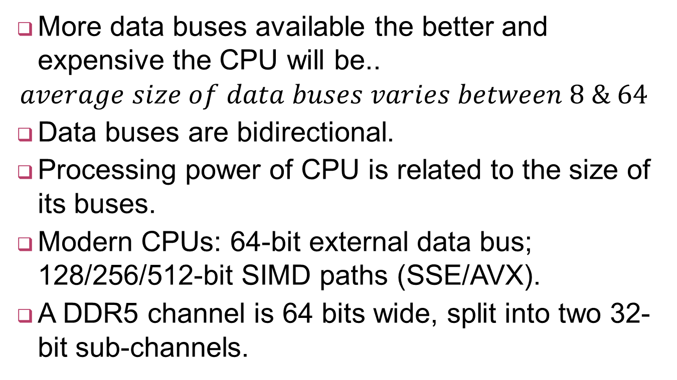
More about Data Bus..
More data buses available the better and expensive the CPU will be..
$$average size of data buses varies between 8 \& 64$$
Data buses are bidirectional.
Processing power of CPU is related to the size of its buses.
Modern CPUs: 64-bit external data bus; 128/256/512-bit SIMD paths (SSE/AVX).
A DDR5 channel is 64 bits wide, split into two 32-bit sub-channels.

Slide 26
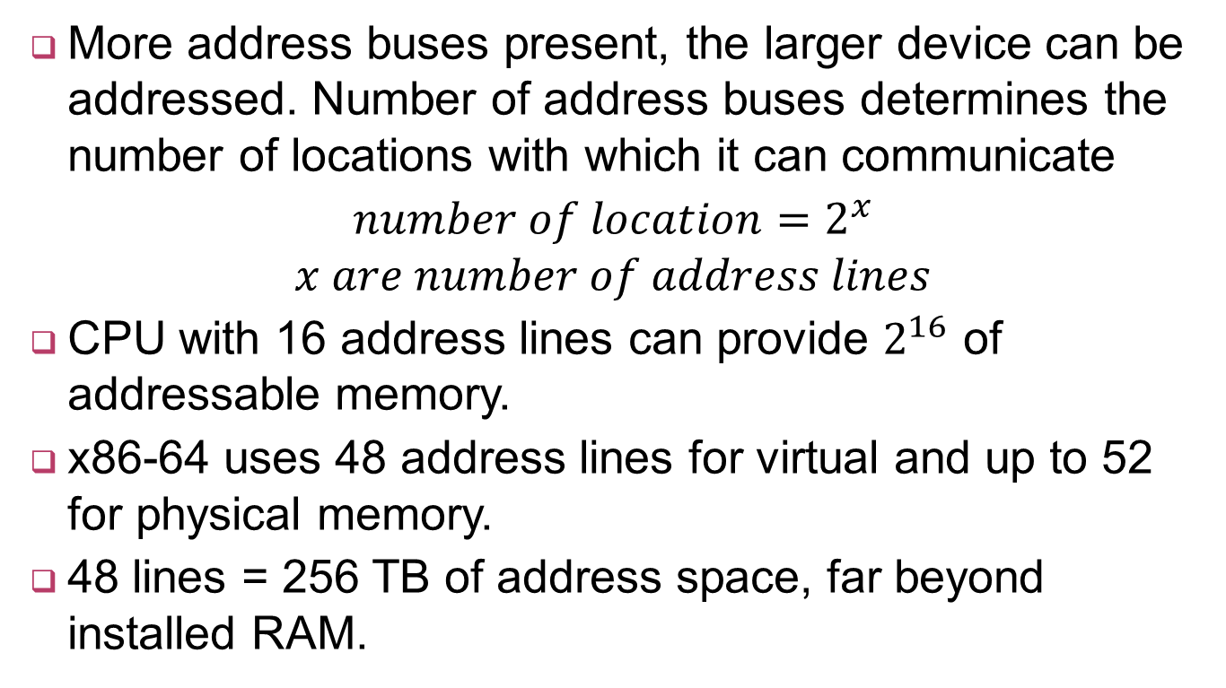
More about Address Bus
More address buses present, the larger device can be addressed. Number of address buses determines the number of locations with which it can communicate
$number of location=2^{x}$ $x are number of address lines$
CPU with 16 address lines can provide $2^{16 }$of addressable memory.
x86-64 uses 48 address lines for virtual and up to 52 for physical memory.
48 lines = 256 TB of address space, far beyond installed RAM.

Slide 27
Address Bus Width: 16 to 64 Bits
Address Lines | Addressable Locations | Where You See It
16 | 2¹⁶ = 64 K | Intel 8085 (1976)
20 | 2²⁰ = 1 MB | Intel 8086 (1978)
32 | 2³² = 4 GB | IA-32 / Pentium
48 | 2⁴⁸ = 256 TB | x86-64 virtual address
52 | 2⁵² = 4 PB | x86-64 physical limit
64 | 2⁶⁴ = 16 EB | Architectural ceiling
Doubling the address bus does not double memory — it squares the reach.

Slide 28
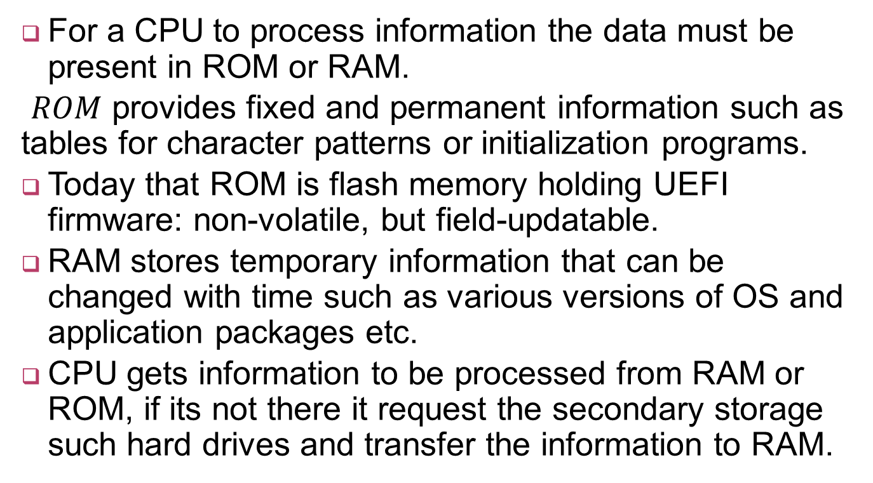
CPU and Its relation to RAM & ROM
For a CPU to process information the data must be present in ROM or RAM.
$ROM$ provides fixed and permanent information such as tables for character patterns or initialization programs.
Today that ROM is flash memory holding UEFI firmware: non-volatile, but field-updatable.
RAM stores temporary information that can be changed with time such as various versions of OS and application packages etc.
CPU gets information to be processed from RAM or ROM, if its not there it request the secondary storage such hard drives and transfer the information to RAM.

Slide 29
The Modern Memory Hierarchy
Level | Typical Size | Access Time | Managed By
L1 cache | 32–64 KB / core | ~1 ns | Hardware
L2 cache | 0.5–2 MB / core | ~4 ns | Hardware
L3 cache | 8–64 MB shared | ~15 ns | Hardware
Main memory (DDR5) | 8–64 GB | ~80 ns | Operating system
NVMe SSD | 256 GB – 4 TB | ~50 µs | Operating system

Slide 30

Memory Capacity
Number of bits that semiconductor memory can store is chip capacity.
$memory can be in units of kbits, Mbits ..$

Slide 31

Memory Organization
A memory chip contains $2^{x}$ locations- $x are address pins$
Each location contains $y bits$ - $y is the number od data pins on the chip$
Entire chip will contain $2^{x}$ $∗y bits$

Slide 32
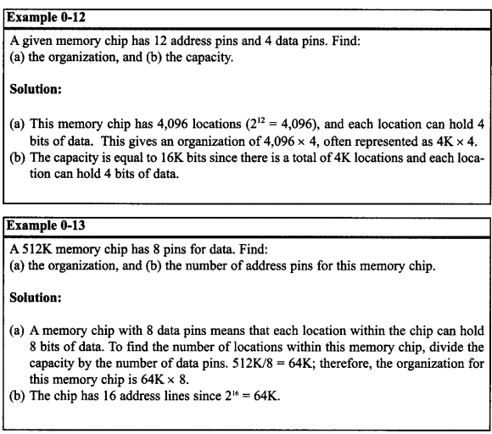
Examples.. Finding Capacity & Organization of memory..

Slide 33
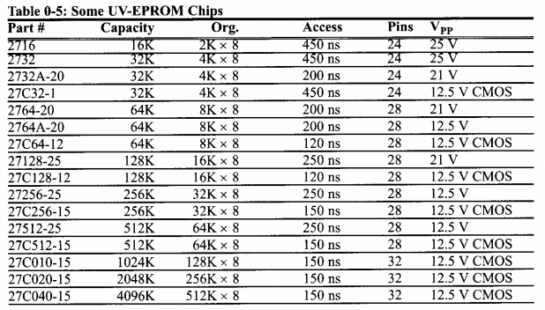
Capacity & Org. of Some UV-EPROM Chips…

Slide 34
Inside CPU
The CPU uses registers to store information temporarily
Registers can be 8-bit, 16-bit, 32-bit or even 64-bit
More and bigger registers, the better the CPU.
CPU cost is increased with more and bigger registers.
CPU is having ALU for performing athematic functions
Program counter in the CPU points to the address of the next instruction to be executed.
Instruction decoder in CPU interpret the instruction fetch into he CPU
CPU capable of understanding more instructions requires more transistors to design

Slide 35
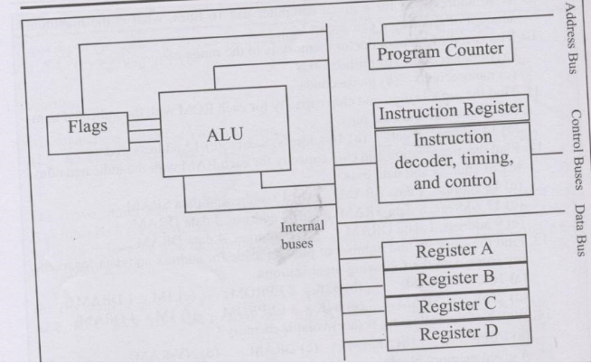
Example Internal Working of CPU

Slide 36
Adding three numbers
Add numbers 21, 42 and 12
Which system unit will add the two numbers? (Register, ALU, Control Unit)
The ALU
Before the ALU can add the numbers, where should the numbers be temporarily stored?
Registers
Assume that CPU has four registers A, B, C & D

Slide 37
Adding three numbers
What is the range of memory address and size of data if the CPU can access data through an 8-bit data bus and 16-bit address bus?
It can access one byte of instruction or data
Address range is 0000 to FFFF H

Slide 38
Adding three numbers
The CPU performs the following actions to add the three numbers
Put 21 into A register
Add to register A the value 42
Add to register A the value 12
The program instructions which implement the above actions are stored in the memory
The code to move the value to register A is
1011 0000 (B0 H)
The code to add the value to register A is
0000 0100 (04 H)

Slide 39
Adding three numbers
Action Code Data
Move value 21 H into reg. A B0 H 21 H
Add value 42 H to reg. A 04 H 42 H
Add value 12 H to reg. A 04 H 12 H
Where should the program be stored?
In the Memory
At which address should the program be stored?
The first address of the memory
But the start address can be any address
Assume first address where instruction is stored is 1400 H

Slide 40
Adding three numbers
Address Instruction
1400 B0
1401 21
1402 04
1403 42
1404 04
1405 12
1406 F4
What is the size of the program? (in bytes)
Seven bytes

Slide 41
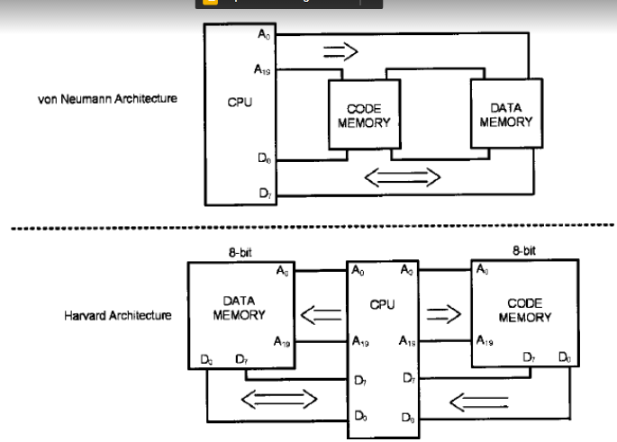
Von Neumann vs. Harvard Architecture

Slide 42
..
Every microprocessor must have memory space to store program (code) and data.
Code provides instruction to the CPU while data provides the information to be processed.
Buses are used to access the code ROM & data RAM memory spaces.
Early computer used the same buses for both code & data - Von Neumann
Such architecture slow down the processing speed of the CPU….

Slide 43
Harvard Architecture in Modern CPUs
Separate buses are used to access code and data- Harvard Architecture
Modern CPUs are modified Harvard: split L1 instruction and L1 data caches feed a unified L2/L3 and a single main memory.
So the programmer sees one Von Neumann memory, while the hardware fetches code and data in parallel.

Slide 44
Modified Harvard: How Real CPUs Split Code and Data
CPU Core
(fetch + execute)
L1 Instruction Cache
(code only)
L1 Data Cache
(data only)
Harvard
inside the
core
Unified L2 / L3 Cache
Main Memory (DDR5)
Von Neumann
outside

Slide 45
Where This Takes You Next
You now know: number systems, buses, registers, memory organization and the fetch–execute cycle.
Assembly
Operating Systems
Architecture
Parallel & AI
Write directly to the registers you just studied.
Memory maps, interrupts and address spaces.
Pipelining, cache design and performance.
GPUs, SIMD and memory-bound ML workloads.
“Master the machine underneath, and every language, framework and model you meet afterwards becomes a detail rather than a mystery.”

